Slide 1


Skynet
Flight Delays Prediction

Slide 2

Think Big:
Who are we?
Think Big is an
independent
pure-play
Big Data services company.

Slide 3


Think Big:
What do we do?
DATA
VALUE

Slide 4



Situation
Skynet FBOs Data Value unknown
Identify Use Case showcasing Value through data
Flight Delay prediction
POC

Slide 5

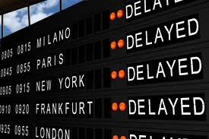



Predicting Flight Delays
Notes:
ARCHITECTURE
AWS cluster
Apache Hadoop
Kylo
Spark
DATA
ADS-B data: Sheldon’s antennae, ADS-B exchange, other publicly available data
DOT data: RITA
FAA data: airplane registry, certification registry
Possibly: FlightAware data, additional data sets
ANALYTICS
Markov Model
Opportunity Analysis

Slide 6
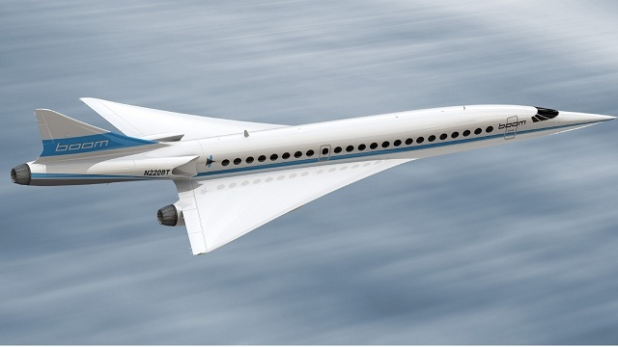
Predicting Flight Delays
70% Accuracy
User Friendly Interface

